Slide 1
TN Oil & Gas Update
2022 Tennessee Oil & Gas Association Convention
Roxanne Reiley, Deputy Director/Oil & Gas Supervisor | October 3, 2022

Slide 2
Division of Mineral & Geologic Resources
Organizational change to separate the mineral extraction regulatory and support programs from the Division of Water Resources. Programs included:
NPDES Mining Unit
Oil & Gas Program
Land Reclamation/Abandoned Mine Lands Program
Surface Coal Mining Program
Tennessee Geologic Survey
Commissioner Salyers designated the DMGR Director as the duly “authorized representative” for the following:
Permitting actions (NPDES, ARAPs, TN Non-Coal Surface Mining Permits, and UIC Class II wells)
Oil & Gas Supervisor was already an authorized representative of the Commissioner
Director’s Orders (CAPs, Civil Penalties, Damages, Consent Orders, and Settlement Agreements)
Responsibilities that remain with DWR:
Fiscal operations, including budget, invoicing, etc.
Water Quality Control, Oil & Gas Board

Slide 3
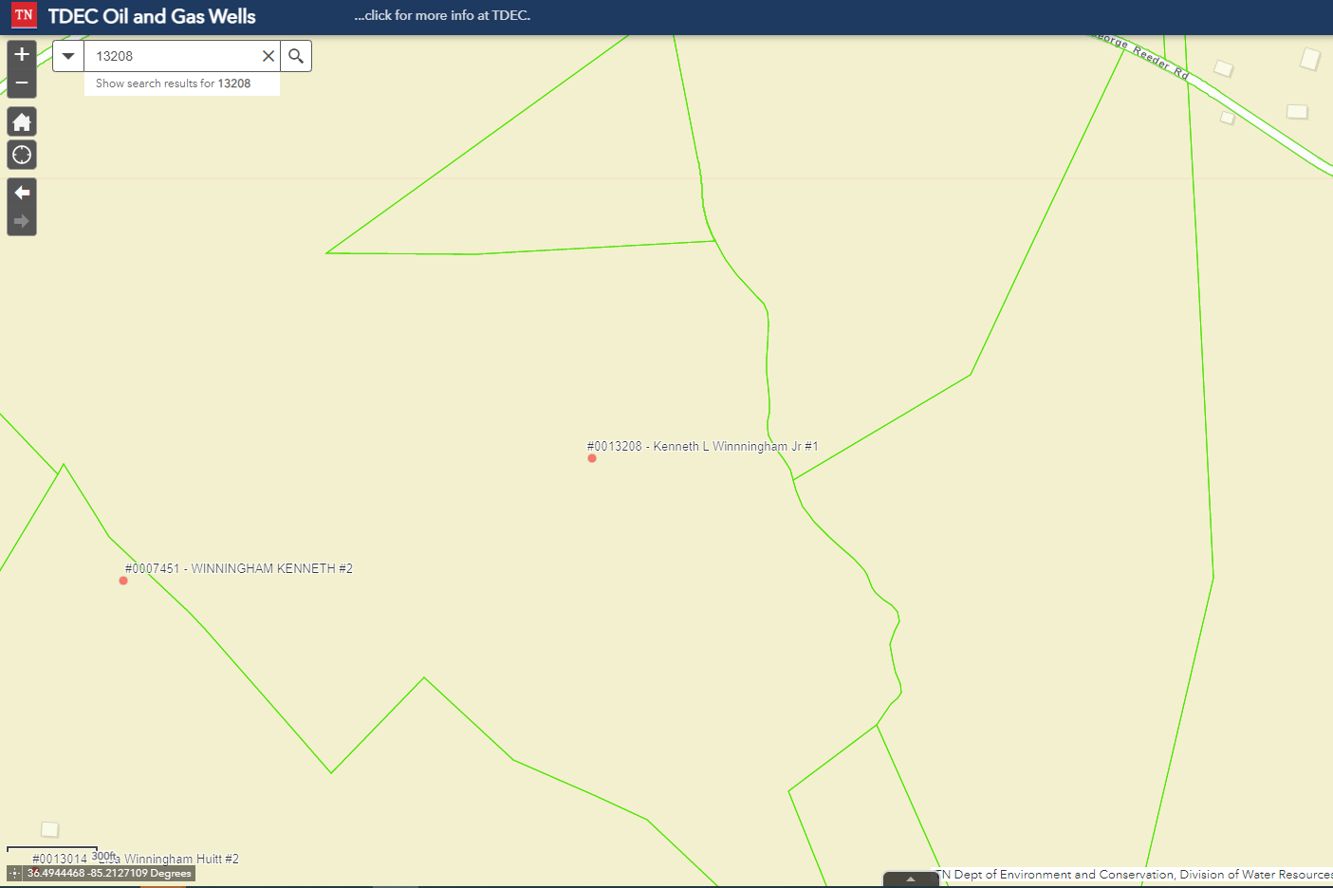
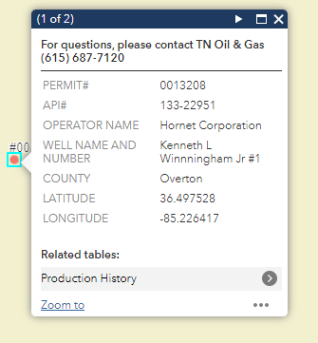
Oil & Gas Online Map
Now updating!
Basic info, but current
Monthly Updates
New Permits
Change of Operators
Lat/Long updates
Amended Well Names

Slide 4
Plugging Contract Updates
Authority found in T.C.A. § 60-1-404 & 60-1-705
Securing Funds:
Penalties & Forfeitures
Eligible Work:
Site Protection & Reclamation on land & water damaged by surface disturbances
Plugging dry or abandoned wells
Plugging wells drilled before January 1, 1988
Supervisor may contract with any person or public agency to perform reclamation work.

Slide 5
Types of State Procurement
Small Procurement <$10,000
Faster, more efficient
Easier to manage
No performance bond
No minimum number of bids
Cooperative effort
Smaller number at any one time, but hopefully just as many in the end.
Formal Procurement >$50,000
Take a long time to prepare and usher through the process
Can be difficult to manage
Performance bond required
Requires at least 3 bids
Rely exclusively on State to prepare contracts
Addresses lots of wells at once
Informal Procurement $10,001 - $49,999
Faster, more efficient
Easier to manage
No performance bond
Requires at least 3 bids
Cooperative effort
Smaller number at any one time, but hopefully just as many in the end.

Slide 6
Plugging Contract Successes
Implemented in Dec. 2021
Plugged 22 wells in FY22
Spent $69,995.80
P.O.s generally issued in 3 days from receipt of bid
Some success stories:
Highland Drilling well – landowner request
Pre-Permit wells – allow operators to drill new wells
G.C. Pemberton #2 – well in the lake

Slide 7
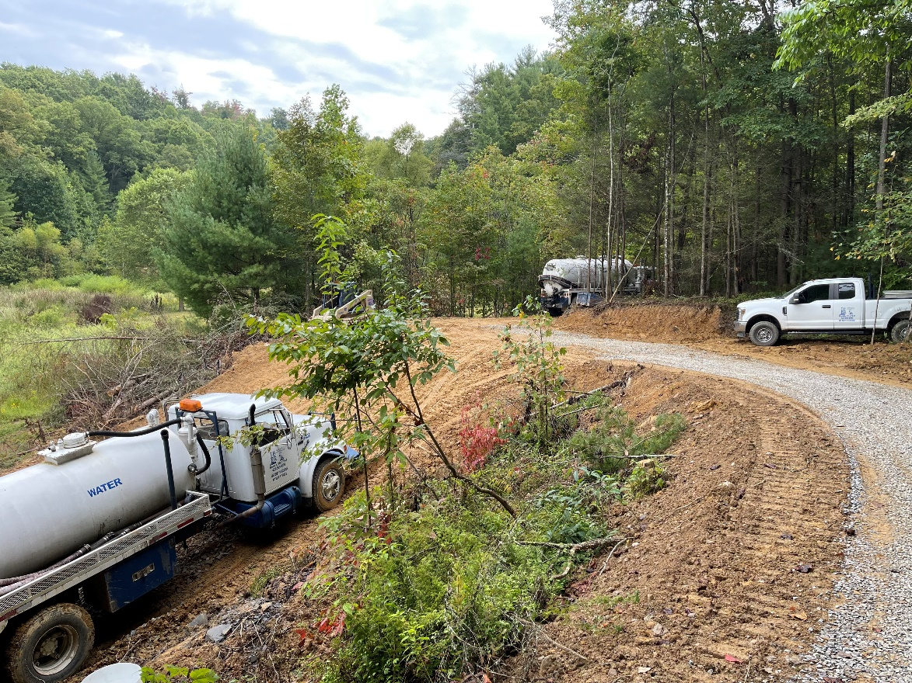

Slide 8
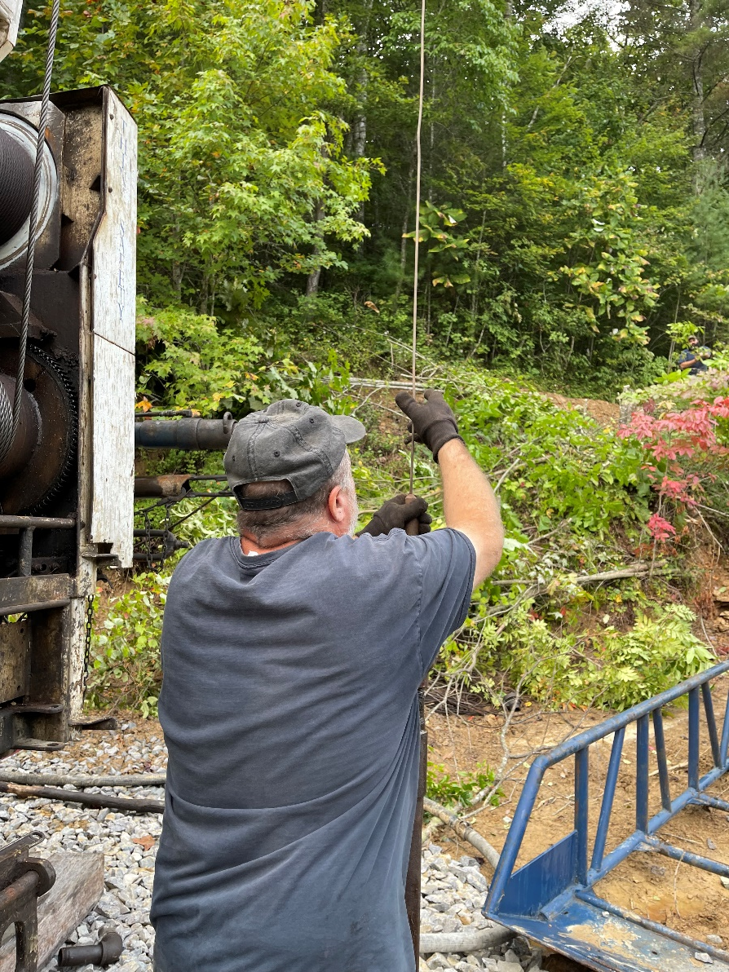
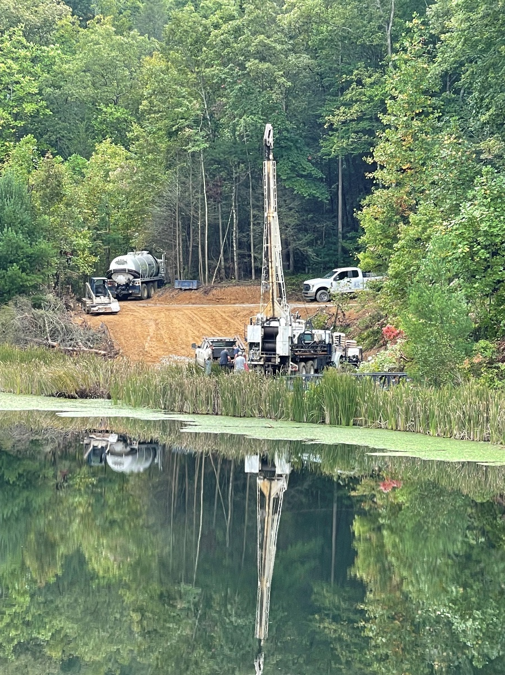

Slide 9
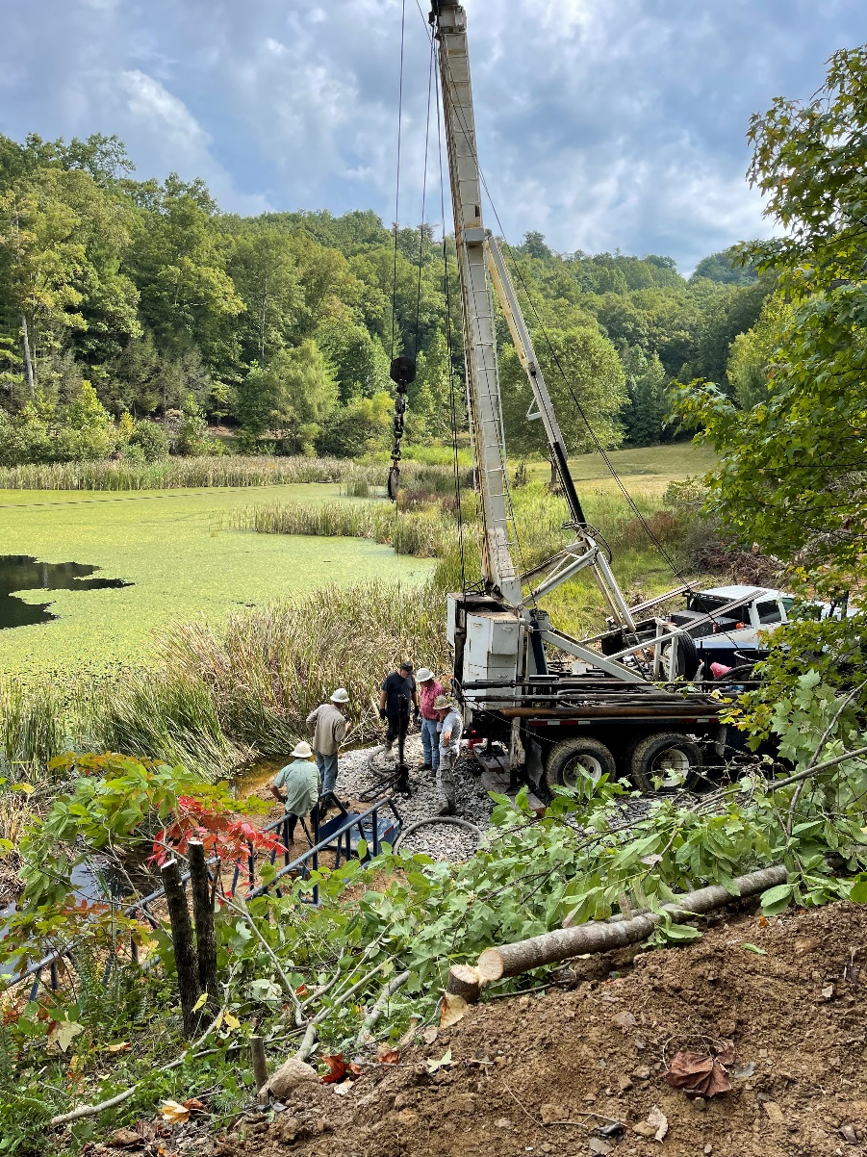
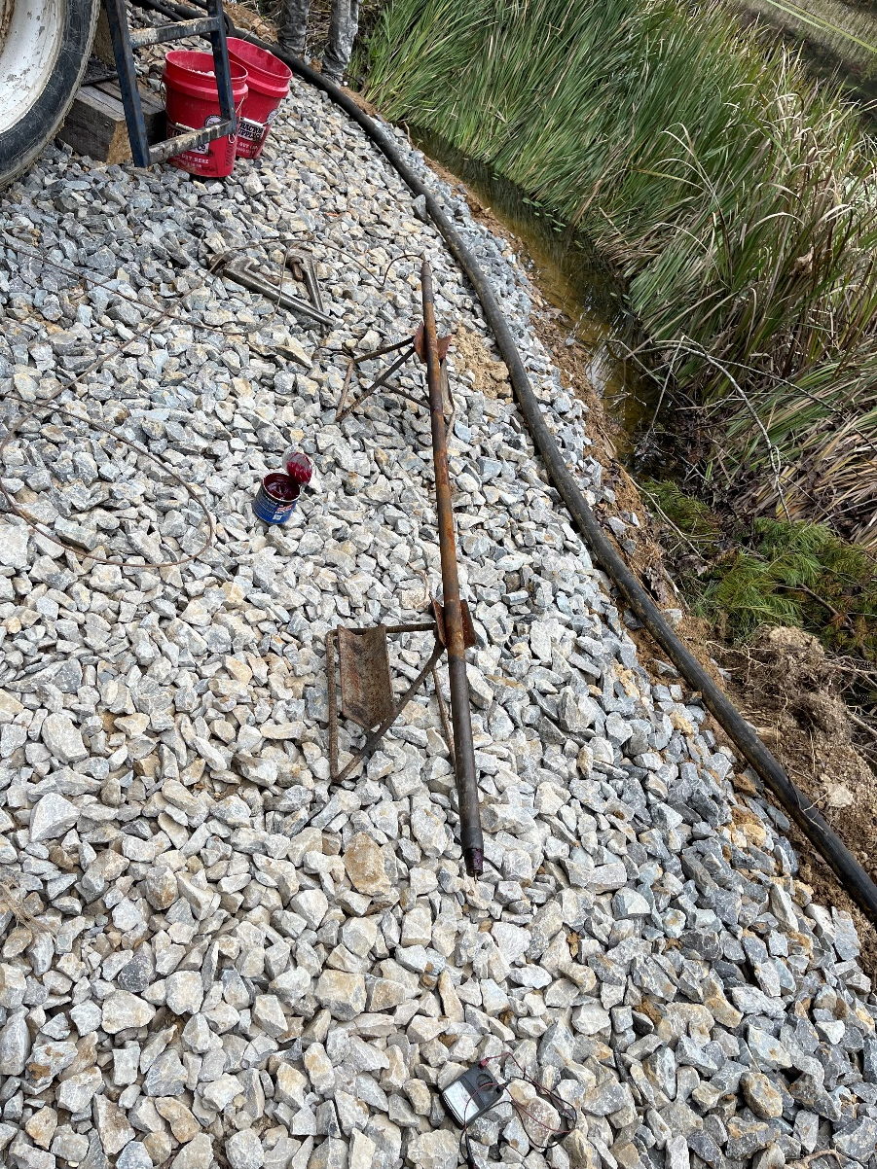

Slide 10
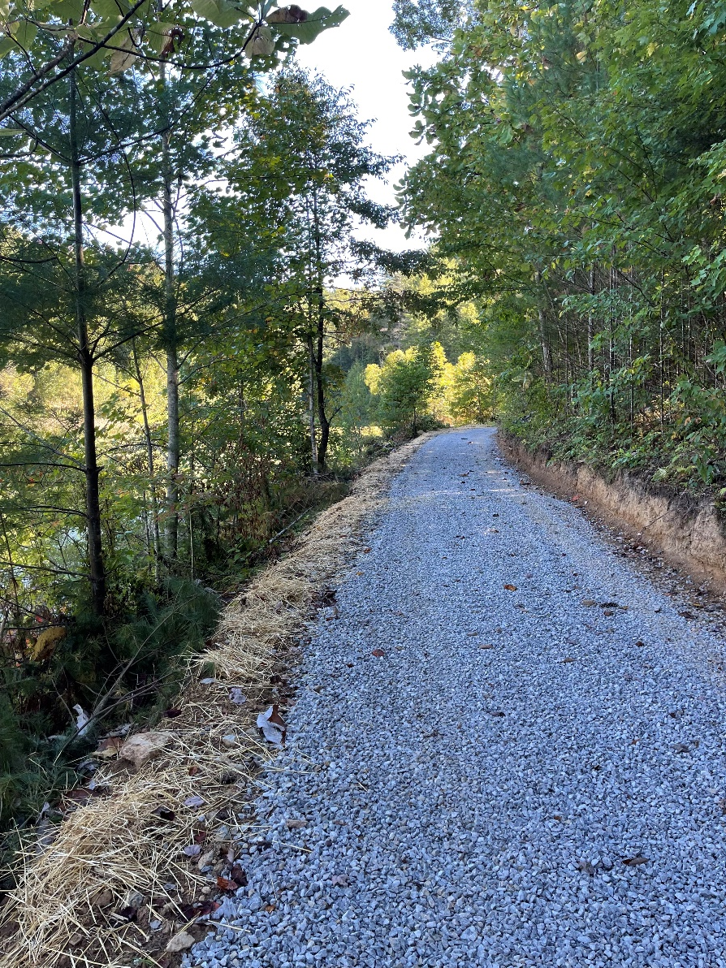
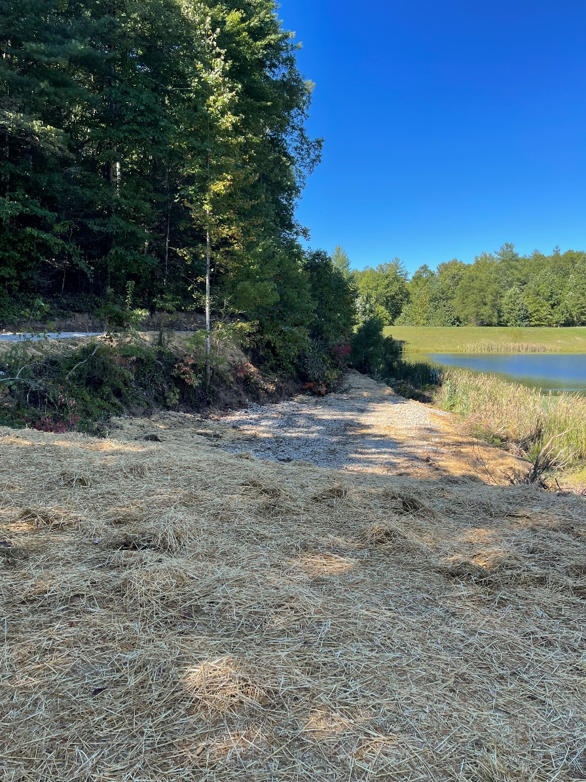

Slide 11
FY2022 Administrative Actions

Slide 12
Compliance Issues
Post signs
Maintain tank pits
Keep sites clear of debris & vegetation mowed down
Bury flow lines
Submit your paperwork
Communication with inspectors

Slide 13
2020 Oil Production
County | Bbls | # of Producing Wells
Anderson | 7,342.18 | 81
Campbell | 3,367.28 | 17
Claiborne | 9,077.87 | 49
Clay | 4,499.67 | 14
Fentress | 25,114.81 | 78
Hancock | 2,754.71 | 4
Morgan | 53,074.16 | 223
Overton | 58,549.75 | 106
Pickett | 8,681.21 | 58
Scott | 39,003.76 | 182
TOTALS | 211,465.40 bbls | 812

Slide 14
2020 Gas Production
County | mcf | # of Producing Wells
Anderson | 1,383,555.63 | 305
Campbell | 259,186.81 | 63
Claiborne | 436,859.38 | 87
Fentress | 34,589 | 45
Morgan | 747,072.68 | 234
Roane | 12,162.00 | 1
Scott | 1,531,908.103 | 198
TOTALS | 4,405,333.60 mcf | 933

Slide 15
Things to Come
Electronic inspection forms!
Improvements to online map
What else do you guys want to see?!
What are your concerns?
Roxanne Reiley
Oil & Gas Supervisor/Deputy Director
roxanne.reiley@tn.gov
865-770-8812

